Slide 1
Artificial Neural Networks
اَعُوذُ بِاللہِ مِنَ الشَّیِطٰنِ الرَّجِیمْ
بِسْمِ اللہِ الرَّحَمٰنِ الرَّحِیمْ
Note: Some slides and/or pictures are adapted from Lecture slides / Books of
https://www.coursera.org/specializations/deep-learning
https://d2l.ai/chapter_preface/index.html
https://deeplearning.cs.cmu.edu/S23/index.html

Slide 2
Contents
AND, OR, XOR
What is a Neural Network?
Neural Network Representation
Vectorization
Activation Function
Why do you need non-linear activation functions
Derivatives of activation functions
Gradient descent for neural networks

Slide 3







AND, OR, XOR
0,1
1,1
1,1
0,1
1,1
0,1
X
X
X
0,0
Y
1,0
Y
0,0
Y
1,0
0,0
1,0
79

Slide 4




What is a Neural Network?
$$x_{1}$$
$$x_{2}$$
$$\hat{y}$$
$$x_{3}$$

Slide 5
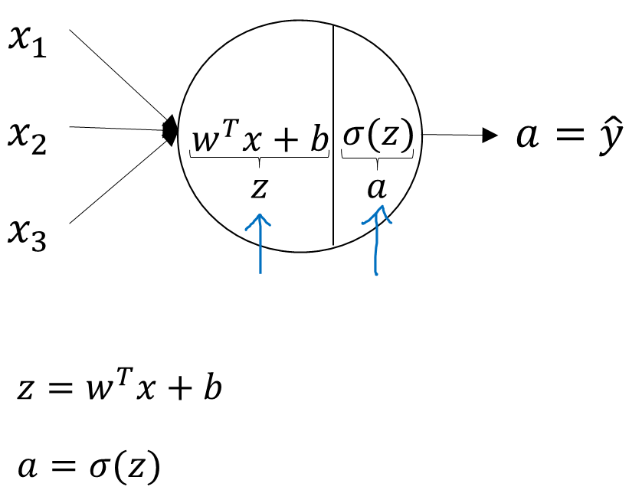



What is a Neural Network?
$$x_{1}$$
$$x_{2}$$
$$\hat{y}$$
$$x_{3}$$
x
w
$$z=w^{T}x+b$$
$$a=σ(z)$$
$$ℒ(a,y)$$
b

Slide 6




What is a Neural Network?
$$x_{1}$$
$$x_{2}$$
$$\hat{y}$$
$$x_{3}$$
x
w
$$z=w^{T}x+b$$
$$a=σ(z)$$
$$ℒ(a,y)$$
b
$$x_{1}$$
$$x_{2}$$
$$\hat{y}$$
$$x_{3}$$

Slide 7
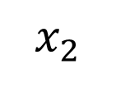
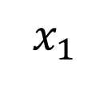

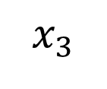
Neural Network Representation
$$x_{1}$$
$$x_{2}$$
$$\hat{y}$$
$$x_{3}$$

Slide 8









What is a Neural Network?
$$x_{1}$$
$$x_{2}$$
$$\hat{y}$$
$$x_{3}$$
x
w
$$z=w^{T}x+b$$
$$a=σ(z)$$
$$ℒ(a,y)$$
b
$$x_{1}$$
$$x_{2}$$
$$\hat{y}$$
$$x_{3}$$
x
$$W^{[1]}$$
$$z^{[1]}=W^{[1]}x+b^{[1]}$$
$$a^{[1]}=σ(z^{[1]})$$
$$z^{[2]}=W^{[2]}a_{ }^{[1]}+b^{[2]}$$
$$a^{[2]}=σ(z^{[2]})$$
$$ℒ(a^{[2]},y)$$
$$b^{[1]}$$
$$W^{[2]}$$
$$b^{[2]}$$

Slide 9














Neural Network Representation
$$x_{1}$$
$$x_{1}$$
$$x_{2}$$
$$σ(z)$$
$$a=\hat{y}$$
$$x_{2}$$
$$\hat{y}$$
$$w^{T}x+b$$
$$z$$
$$a$$
$$x_{3}$$
$$x_{3}$$
$$z=w^{T}x+b$$
$$a=σ(z)$$

Slide 10





Neural Network Representation
$$x_{1}$$
$$x_{1}$$
$$x_{2}$$
$$σ(z)$$
$$a=\hat{y}$$
$$x_{2}$$
$$\hat{y}$$
$$w^{T}x+b$$
$$z$$
$$a$$
$$x_{3}$$
$$x_{3}$$
$$z=w^{T}x+b$$
$$x_{1}$$
$$a=σ(z)$$
$$x_{2}$$
$$\hat{y}$$
$$x_{3}$$

Slide 11

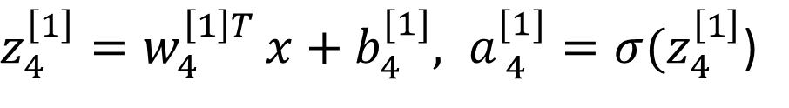


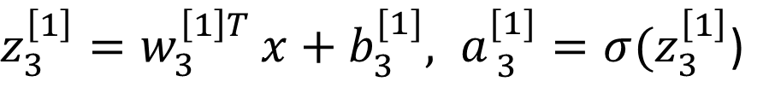


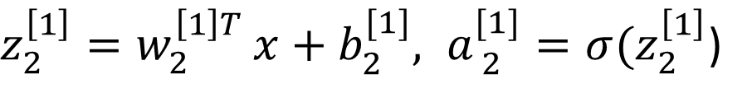

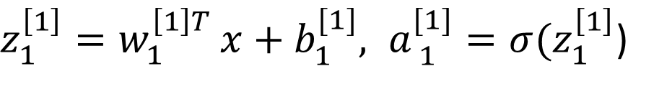


Neural Network Representation
$$a_{1}^{\left[1\right]}$$
$z_{1}^{\left[1\right]}=w_{1}^{{\left[1\right]T}^{ }}x+b_{1}^{[1]}, a_{ 1}^{[1]}=σ(z_{1}^{\left[1\right]}$)
$$x_{1}$$
$$a_{2}^{\left[1\right]}$$
$z_{2}^{\left[1\right]}=w_{2}^{{\left[1\right]T}^{ }}x+b_{2}^{[1]}, a_{ 2}^{[1]}=σ(z_{2}^{\left[1\right]}$)
$$x_{2}$$
$$\hat{y}$$
$$a_{3}^{\left[1\right]}$$
$z_{3}^{\left[1\right]}=w_{3}^{{\left[1\right]T}^{ }}x+b_{3}^{[1]}, a_{ 3}^{[1]}=σ(z_{3}^{\left[1\right]}$)
$$x_{3}$$
$$a_{4}^{\left[1\right]}$$
$z_{4}^{\left[1\right]}=w_{4}^{{\left[1\right]T}^{ }}x+b_{4}^{[1]}, a_{ 4}^{[1]}=σ(z_{4}^{\left[1\right]}$)

Slide 12




Neural Network Representation learning
$$a_{1}^{\left[1\right]}$$
Given input x:
$$x_{1}$$
$$a_{2}^{\left[1\right]}$$
$$z^{\left[1\right]}=W^{\left[1\right]}x+b^{\left[1\right]}$$
$$x_{2}$$
$$\hat{y}$$
$$a_{3}^{\left[1\right]}$$
$$x_{3}$$
$$a^{\left[1\right]}=σ(z^{\left[1\right]})$$
$$a_{4}^{\left[1\right]}$$
$$z^{\left[2\right]}=W^{\left[2\right]}a^{\left[1\right]}+b^{\left[2\right]}$$
$$a^{\left[2\right]}=σ(z^{\left[2\right]})$$

Slide 13








Vectorizing across multiple examples
$$z^{\left[1\right]}=W^{\left[1\right]}x+b^{\left[1\right]}$$
$$x_{1}$$
$$a^{\left[1\right]}=σ(z^{\left[1\right]})$$
$$x_{2}$$
$$\hat{y}$$
$$z^{\left[2\right]}=W^{\left[2\right]}a^{\left[1\right]}+b^{\left[2\right]}$$
$$x_{3}$$
$$a^{\left[2\right]}=σ(z^{\left[2\right]})$$

Slide 14




Vectorizing across multiple examples
for i = 1 to m:
$$z^{\left[1\right](i)}=W^{\left[1\right]}x^{(i)}+b^{\left[1\right]}$$
$$a^{\left[1\right](i)}=σ(z^{\left[1\right]\left(i\right)})$$
$$z^{\left[2\right](i)}=W^{\left[2\right]}a^{\left[1\right](i)}+b^{\left[2\right]}$$
$$a^{\left[2\right](i)}=σ(z^{\left[2\right]\left(i\right)})$$

Slide 15
Vectorizing across multiple examples
for i = 1 to m:
$$z^{\left[1\right](i)}=W^{\left[1\right]}x^{(i)}+b^{\left[1\right]}$$
$$a^{\left[1\right](i)}=σ(z^{\left[1\right]\left(i\right)})$$
$$z^{\left[2\right](i)}=W^{\left[2\right]}a^{\left[1\right](i)}+b^{\left[2\right]}$$
$$a^{\left[2\right](i)}=σ(z^{\left[2\right]\left(i\right)})$$

Slide 16




















Recap of vectorizing across multiple examples
for i = 1 to m
$$x_{1}$$
$$z^{\left[1\right](i)}=W^{\left[1\right]}x^{(i)}+b^{\left[1\right]}$$
$$x_{2}$$
$$\hat{y}$$
$$x_{3}$$
$$a^{\left[1\right](i)}=σ(z^{\left[1\right]\left(i\right)})$$
$$z^{\left[2\right](i)}=W^{\left[2\right]}a^{\left[1\right](i)}+b^{\left[2\right]}$$
$$a^{\left[2\right](i)}=σ(z^{\left[2\right]\left(i\right)})$$
$$X=$$
$$x^{(1)}$$
$$x^{(2)}$$
…
$$x^{(m)}$$
$$Z^{\left[1\right]}=W^{\left[1\right]}X+b^{\left[1\right]}$$
$$A^{\left[1\right]}=σ(Z^{\left[1\right]})$$
$$Z^{\left[2\right]}=W^{\left[2\right]}A^{\left[1\right]}+b^{\left[2\right]}$$
$A^{[1]}=$
$$a^{[1](1)}$$
$$a^{[1](2)}$$
$$a^{[1](m)}$$
…
$$A^{\left[2\right]}=σ(Z^{\left[2\right]})$$

Slide 17








Activation functions
$$x_{1}$$
$$x_{2}$$
$$\hat{y}$$
$$x_{3}$$
Given x:
$$z^{\left[1\right]}=W^{\left[1\right]}x+b^{\left[1\right]}$$
$$a^{\left[1\right]}=σ(z^{\left[1\right]})$$
$$z^{\left[2\right]}=W^{\left[2\right]}a^{\left[1\right]}+b^{\left[2\right]}$$
$$a^{\left[2\right]}=σ(z^{\left[2\right]})$$

Slide 18
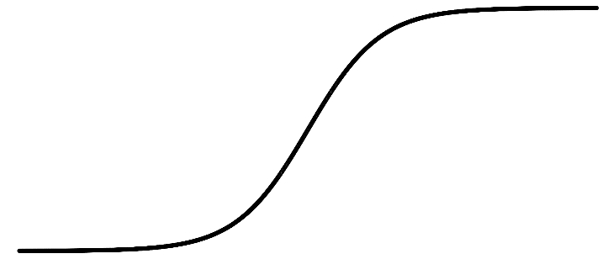
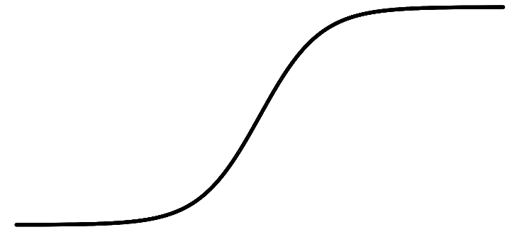
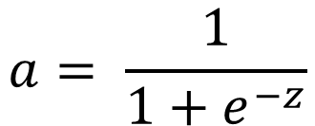
Pros and cons of activation functions
a
a
x
z
$$a= \frac{1}{1+e^{−z}}$$
sigmoid:
a
a
z
z

Slide 19
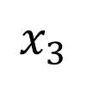



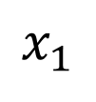



Why do you need non-linear activation functions
$$x_{1}$$
$$x_{2}$$
$$\hat{y}$$
$$x_{3}$$
Given x:
$$z^{\left[1\right]}=W^{\left[1\right]}x+b^{\left[1\right]}$$
$$a^{\left[1\right]}=g^{[1]}(z^{\left[1\right]})$$
$$z^{\left[2\right]}=W^{\left[2\right]}a^{\left[1\right]}+b^{\left[2\right]}$$
$$a^{\left[2\right]}=g^{[2]}(z^{\left[2\right]})$$

Slide 20
Derivatives of
activation functions

Slide 21
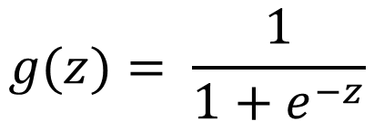
Sigmoid activation function
a
$$g(z)= \frac{1}{1+e^{−z}}$$
z

Slide 22
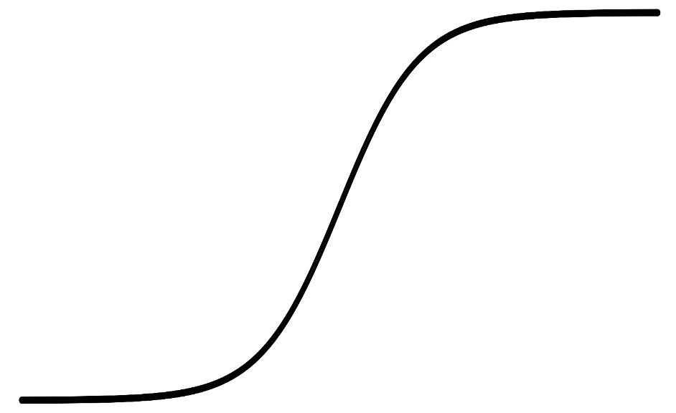

Tanh activation function
a
$$g(z)=tanh(z){ }$$
z

Slide 23
ReLU and Leaky ReLU
a
a
z
z
ReLU
Leaky ReLU

Slide 24
Gradient descent for neural networks

Slide 25
Formulas for computing derivatives

Slide 26
One hidden layer
Neural Network
Backpropagation
intuition

Slide 27






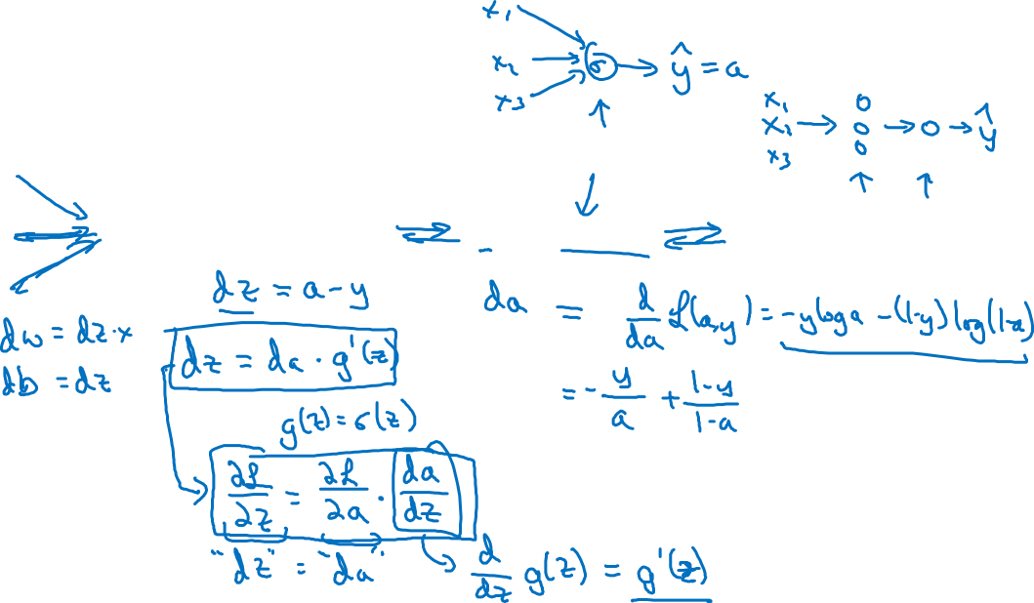
Computing gradients
Logistic regression
$$x$$
$$w$$
$$z=w^{T}x+b$$
$$a= σ(z)$$
$$ℒ(a,y)$$
$$b$$

Slide 28

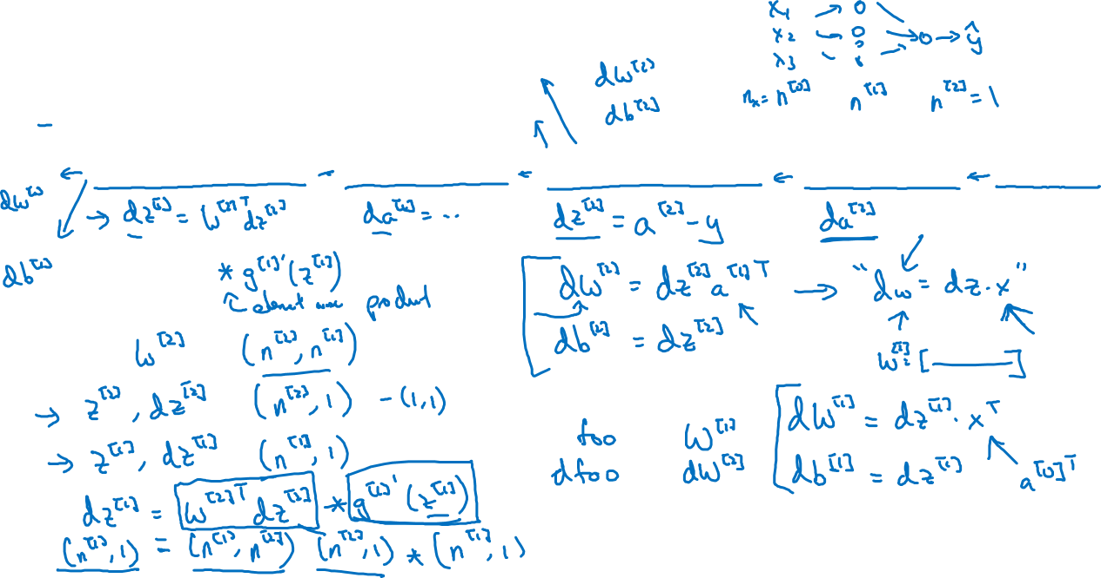



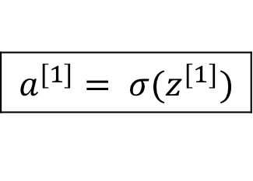


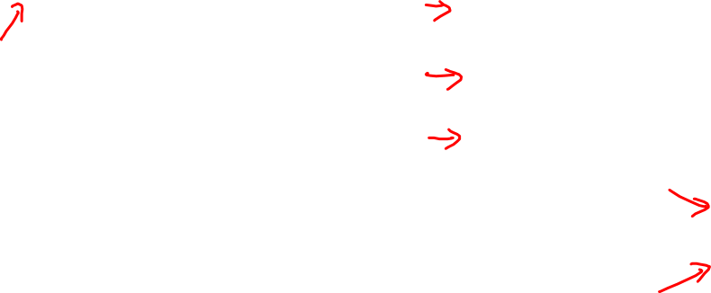


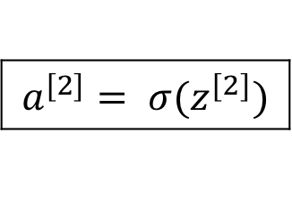
Neural network gradients
$$W^{[2]}$$
$$x$$
$$b^{[2]}$$
$$W^{[1]}$$
$$z^{[1]}=W^{[1]}x+b^{[1]}$$
$$a^{[1]}= σ(z^{[1]})$$
$$z^{[2]}=W^{[2]}x+b^{[2]}$$
$$a^{[2]}= σ(z^{[2]})$$
$$ℒ(a^{[2]},y)$$
$$b^{[1]}$$

Slide 29





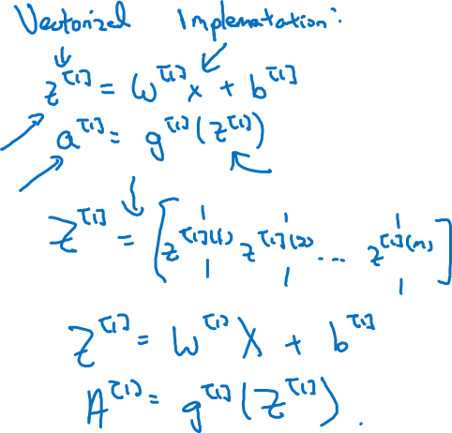
Summary of gradient descent
$$dz^{[2]}=a^{[2]}−y$$
$$dW^{[2]}=dz^{[2]}a^{{\left[1\right]}^{T}}$$
$$db^{[2]}=dz^{[2]}$$
$$dz^{[1]}=W^{\left[2\right]T}dz^{[2]}∗g^{[1]}′(z^{\left[1\right]})$$
$$dW^{[1]}=dz^{[1]}x^{T}$$
$$db^{[1]}=dz^{[1]}$$

Slide 30

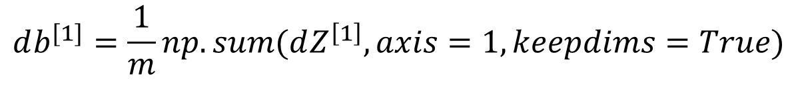
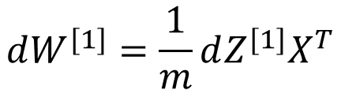
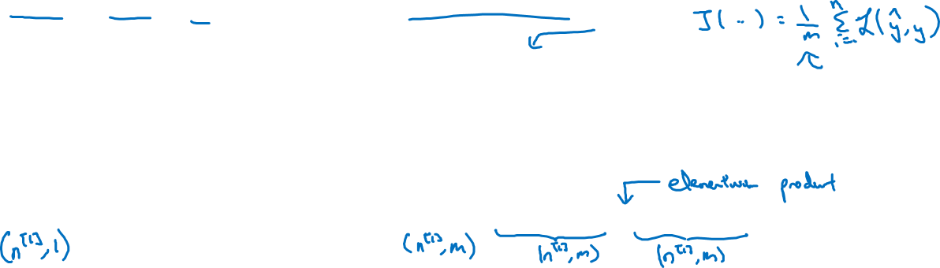
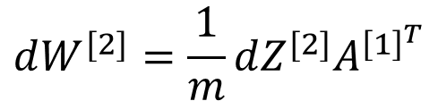
Summary of gradient descent
$$dz^{[2]}=a^{[2]}−y$$
$$dZ^{[2]}=A^{[2]}−Y$$
$$dW^{[2]}=dz^{[2]}a^{{\left[1\right]}^{T}}$$
$$dW^{[2]}=\frac{1}{m}dZ^{[2]}A^{{\left[1\right]}^{T}}$$
$$db^{[2]}=dz^{[2]}$$
$$db^{[2]}=\frac{1}{m}np.sum(dZ^{\left[2\right]},axis=1, keepdims=True)$$
$$dz^{[1]}=W^{\left[2\right]T}dz^{[2]}∗g^{[1]}′(z^{\left[1\right]})$$
$$dZ^{[1]}=W^{\left[2\right]T}dZ^{[2]}∗g^{[1]}′(Z^{\left[1\right]})$$
$$dW^{[1]}=dz^{[1]}x^{T}$$
$$dW^{[1]}=\frac{1}{m}dZ^{[1]}X^{T}$$
$$db^{[1]}=dz^{[1]}$$
$$db^{[1]}=\frac{1}{m}np.sum(dZ^{\left[1\right]},axis=1, keepdims=True)$$

Slide 31
One hidden layer
Neural Network
Random Initialization

Slide 32






What happens if you initialize weights to zero?
$$x_{1}$$
$$a_{1}^{[1]}$$
$$a_{1}^{[2]}$$
$$\hat{y}$$
$$x_{2}$$
$$a_{2}^{[1]}$$

Slide 33
Random initialization
$$x_{1}$$
$$a_{1}^{[1]}$$
$$a_{1}^{[2]}$$
$$\hat{y}$$
$$x_{2}$$
$$a_{2}^{[1]}$$

Slide 34
Q & A

